Slide 1


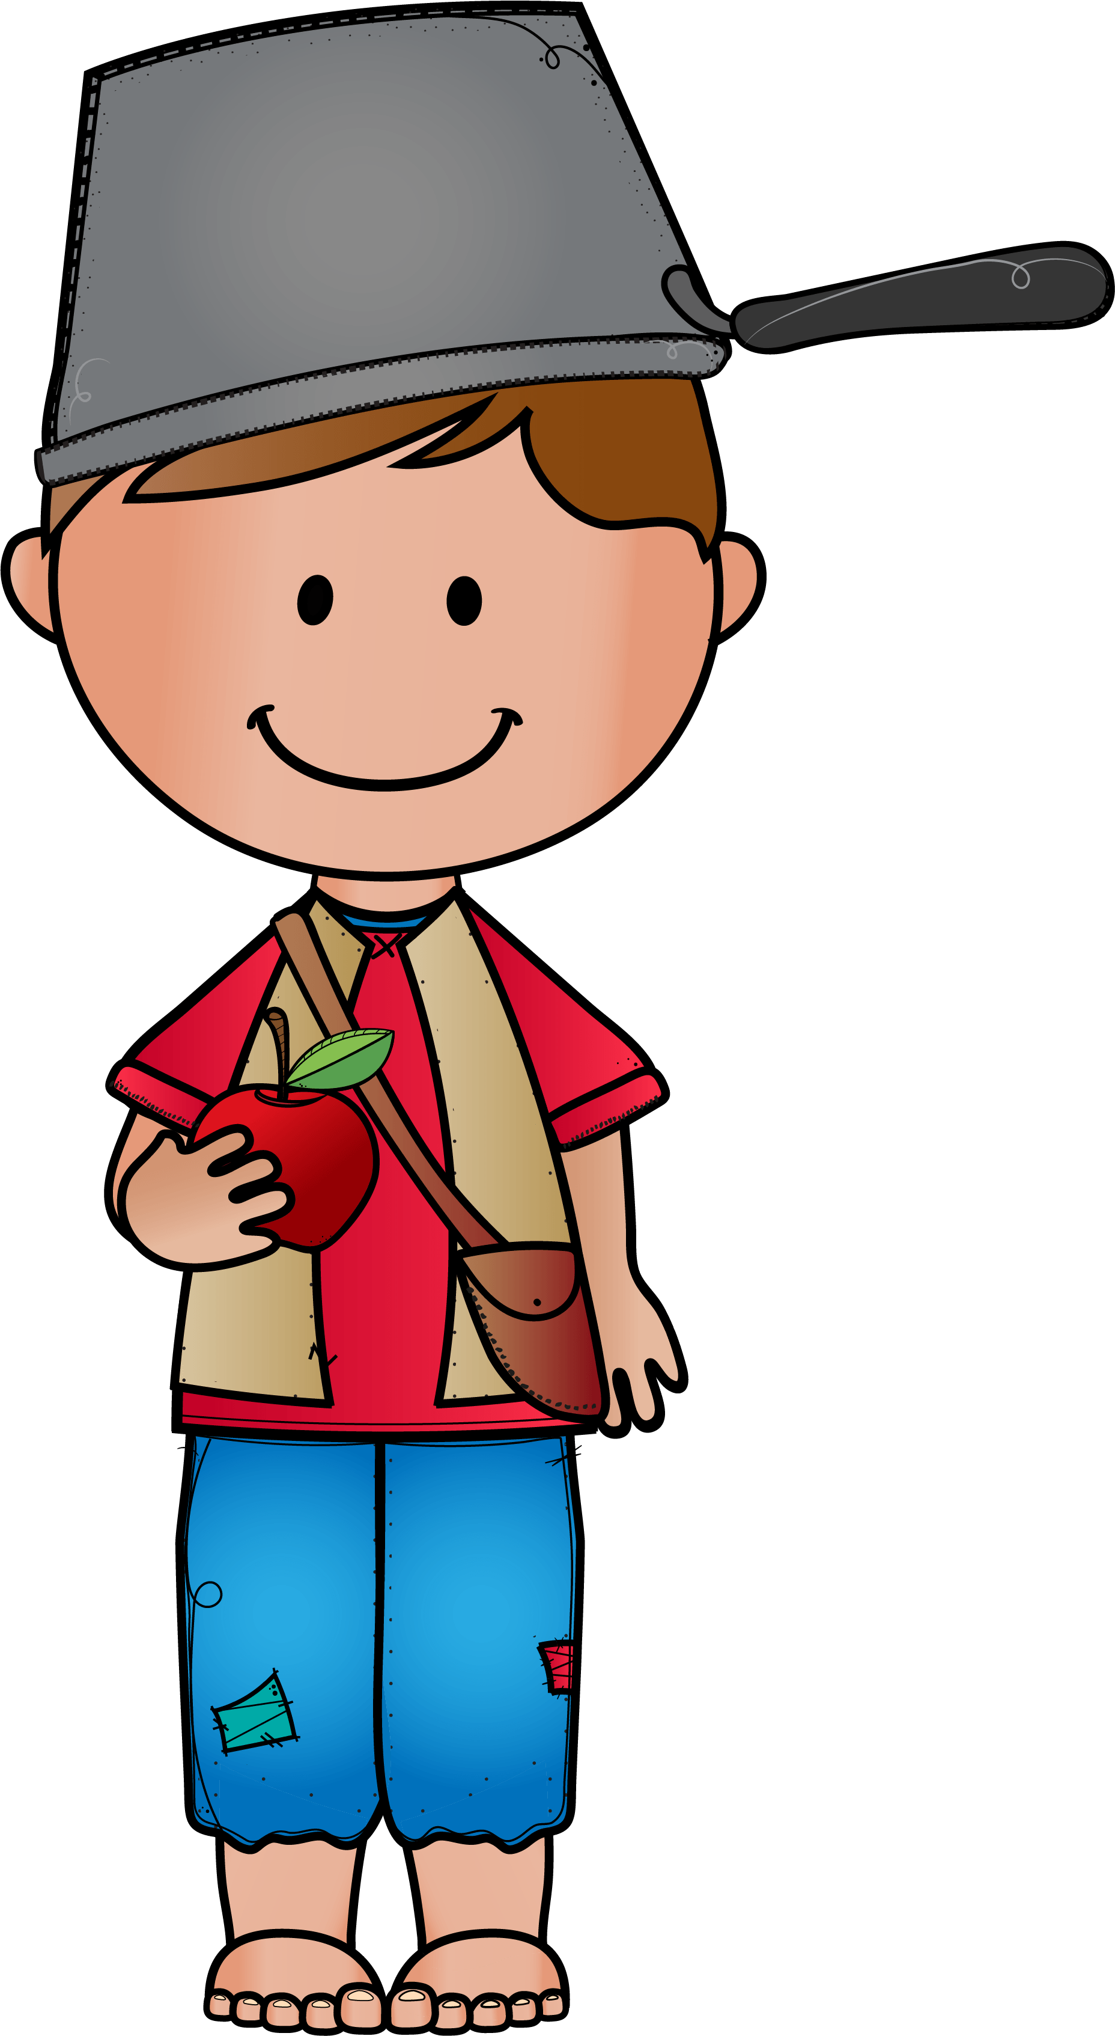




Free Writing Prompt
PRINT-N-GO
Showing Kindness like Johnny
© 2025

Slide 2

©2025penguineducationaliceberg.com
Background Knowledge Johnny Appleseed was born in Leominster, Massachusetts on September 26, 1774. His real name was John Chapman, but his nickname was Johnny Appleseed because of his love for growing apple trees. He showed kindness to the people who were moving west into the wilderness. Johnny grew trees and supplied apple seeds to the pioneers settling in parts of Pennsylvania, Ohio, Indiana, and Illinois. He traveled “light”, hence the pot on his head. ;-)

Slide 3
What kindness could you share in honor of Johnny Appleseed?
Brainstorm Acts of Kindness
How to use this page:
Project on a screen.
Enlarge and print to a poster size.
Record responses with the entire class.
Record responses in small groups.
Give small groups their own page to record their responses and then share with the whole class.
©2025penguineducationaliceberg.com

Slide 4
What kindness could you share in honor of Johnny Appleseed?
©2025penguineducationaliceberg.com

Slide 5

What kindness could you share in honor of Johnny Appleseed?
How to use the Writing Pot Templates
Put your name on the pot handle.
Write/draw about an act of kindness on the pot choosing from these 11 writing choices:
Slide 6 The kiddos will draw an act of kindness on the pot, then dictate an explanation of their drawing.
Slides 7-8 Sentence frame is provided. The kiddos will complete the sentence frame on either primary lines sized 20pt or 28pt.
Slides 9-10 Sentence frame is provided. The kiddos will complete the sentence frame on open lines spaced 20pt or 28pt.
Slides 11-12 Sentence frame should be traced. The kiddos will complete the sentence frame on primary lines sized 20pt or 28pt.
Slides 13-14 Sentence frame should be traced. The kiddos will complete the sentence frame on open lines sized 20pt and 28pt.
Slides 15-16 Sentence frame is provided or should be traced. The kiddos will complete the sentence frame in the blank space either with words or drawings.
Complete the drawing of themselves.
©2025penguineducationaliceberg.com

Slide 6
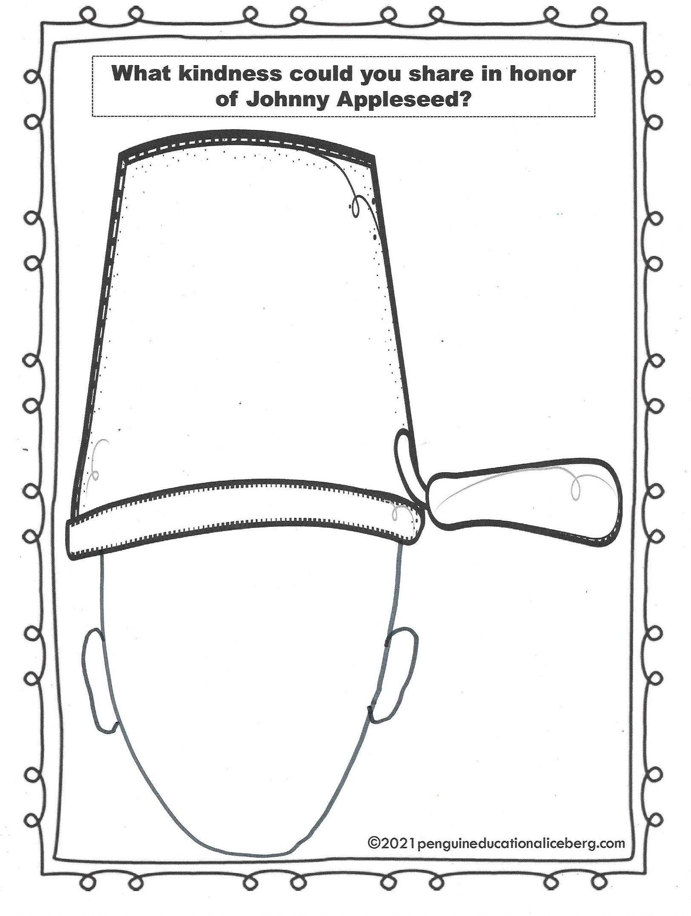

Slide 7
I show kindness by////////////
///////////////////////////////////////////////////////////////////////////

Slide 8
I show kindness by ////////////////////////////////////////////////////////////////////////////////////////////////////////////////////////////////////////////////////////////////

Slide 9
I show kindness by

Slide 10
I show kindness by

Slide 11
I show kindness by ///////////////
///////////////////////////////////////////////////////////////////////////

Slide 12
I show kindness by/////////////////
////////////////////////////////////////////////////////////////////////////////////////////////////////////////////////////////////////////////////////////////

Slide 13
I show kindness by

Slide 14
I show kindness by

Slide 15
I show kindness by

Slide 16
I show kindness by

Slide 17
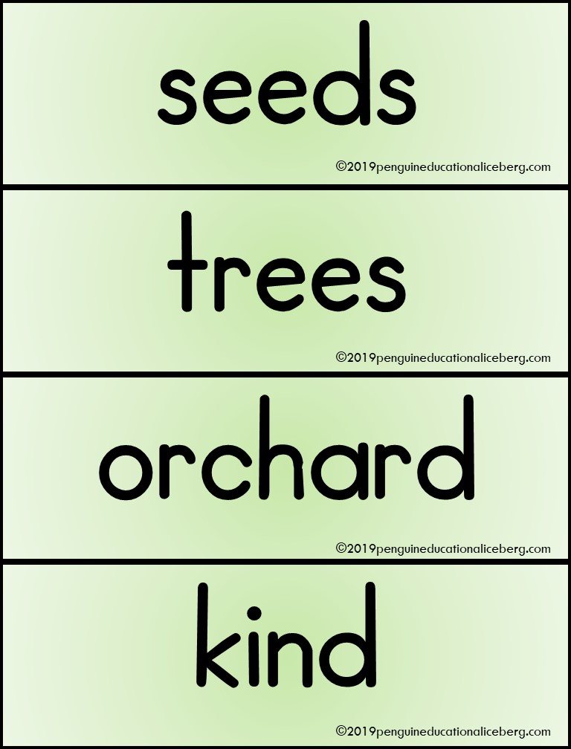

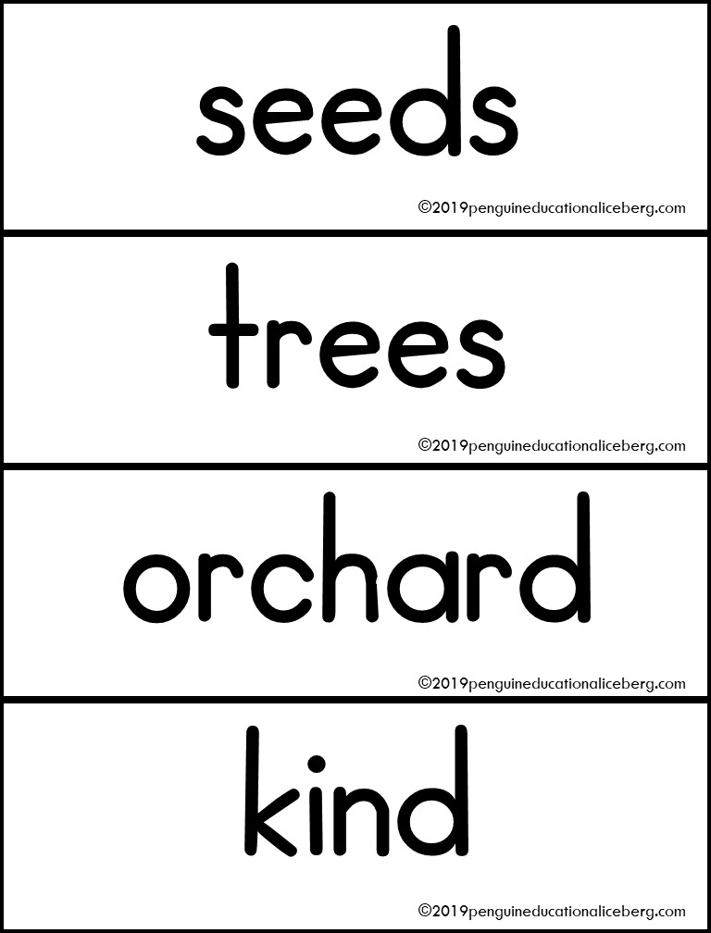
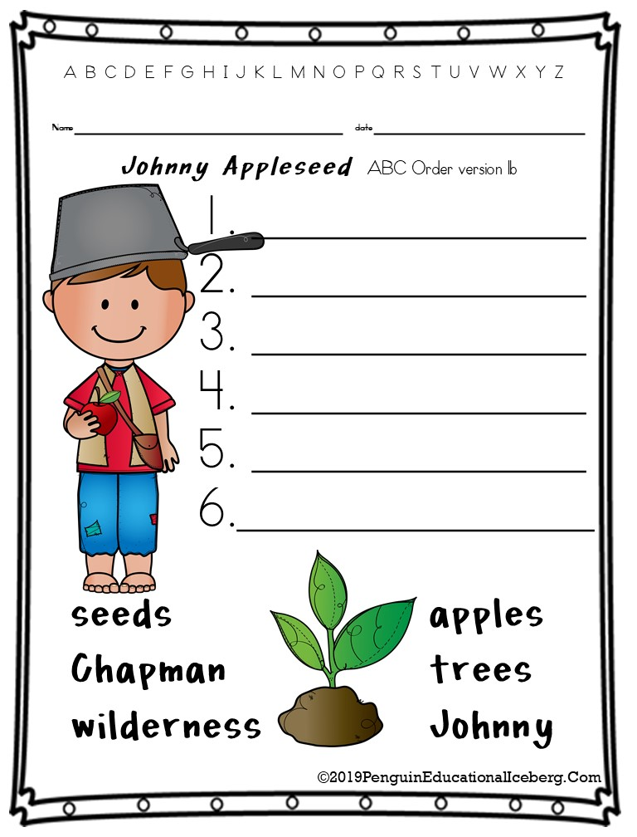
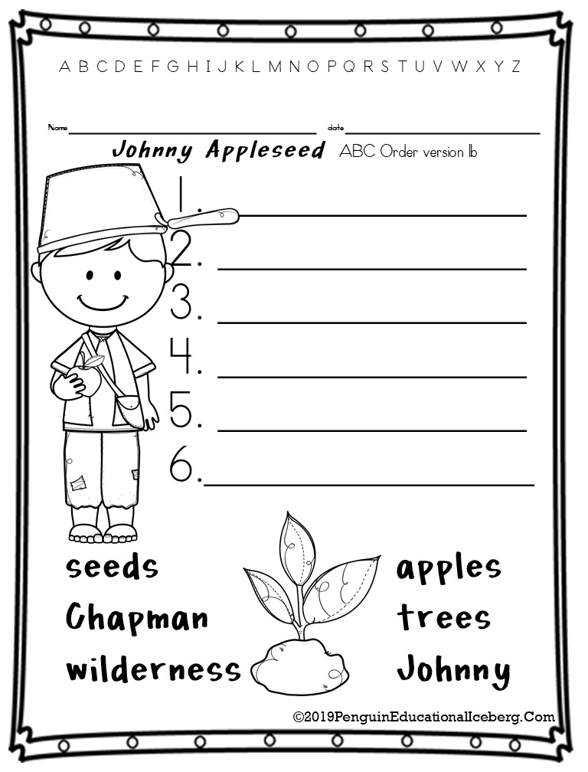
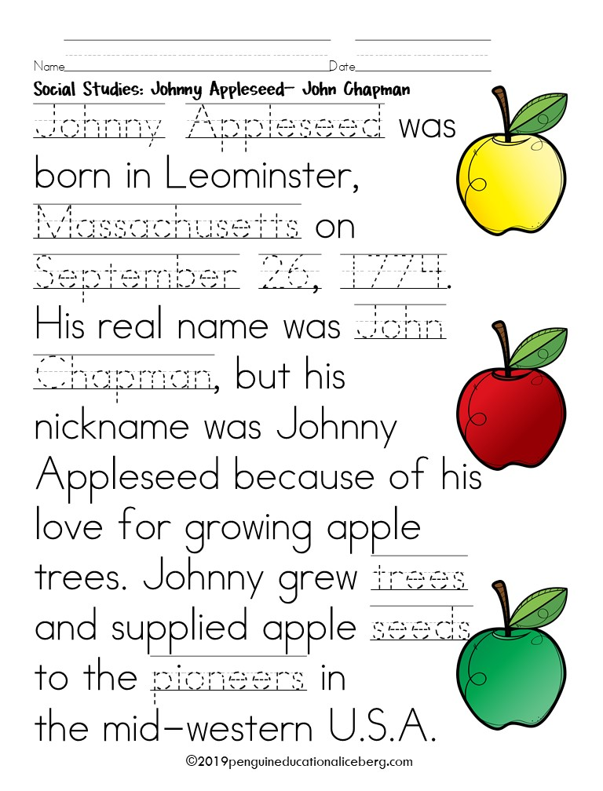
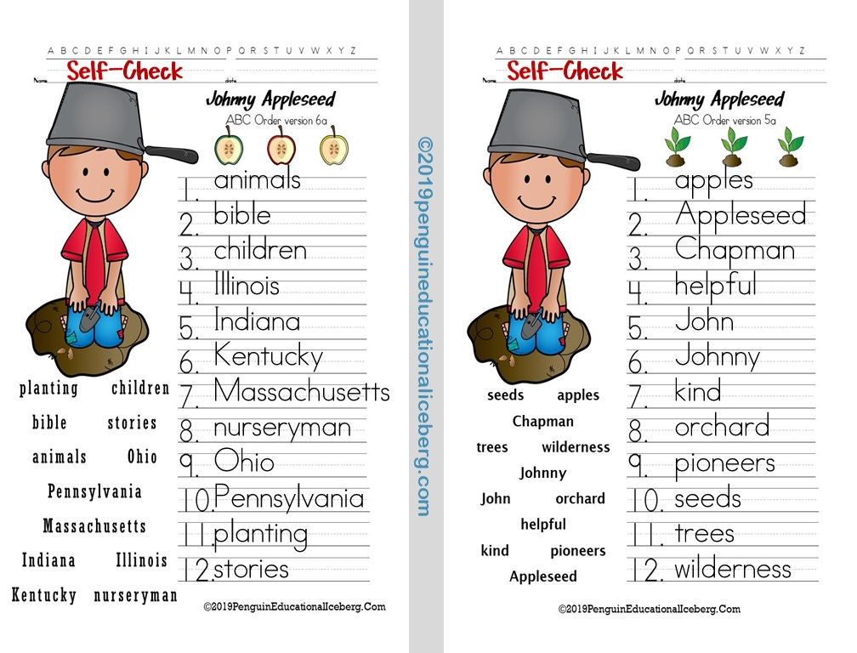
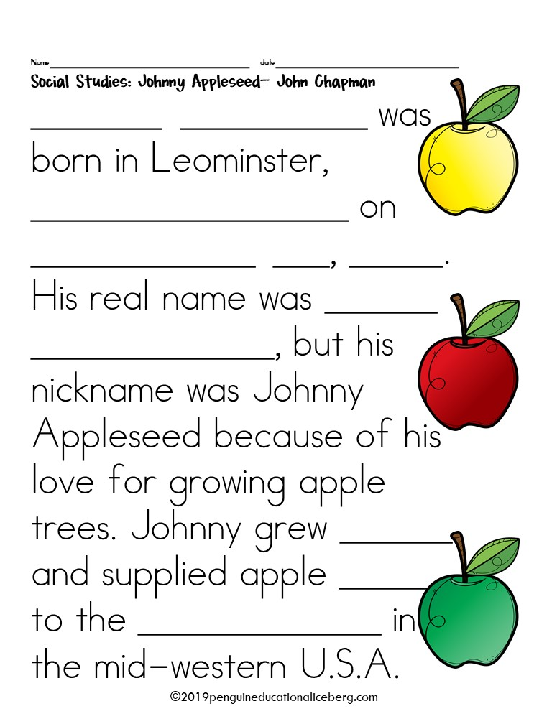
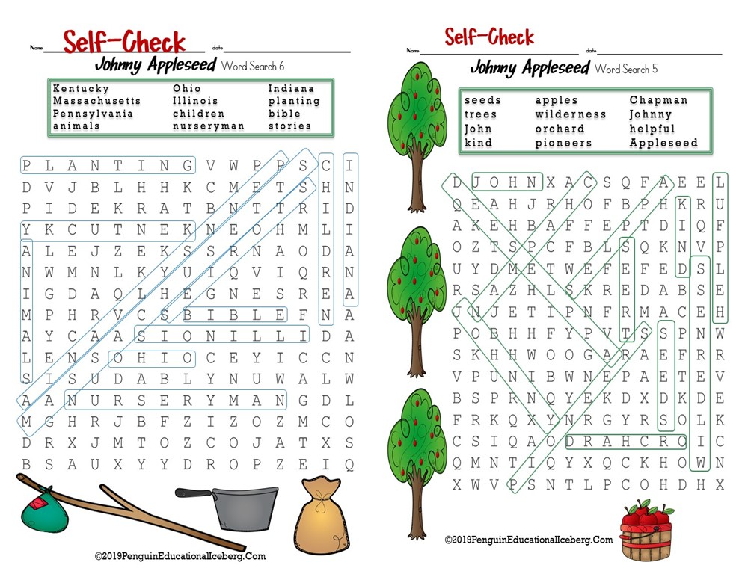

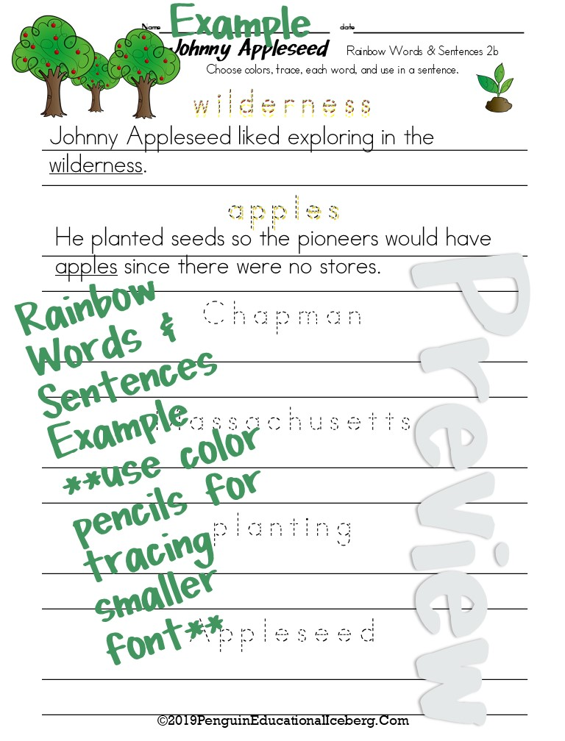
More Johnny Fun at TpT!!
Penguin
Educational
Iceberg
Product Contains:
28 Vocabulary Cards
J. A. Fact Anchor Charts & Statement Completions
ABC Order 4 versions w/ 6 words 2 versions w/12 words Self-Check Cards
Word Searches 4 versions w/ 6 words 2 versions w/12 words Self-Check Cards
Rainbow Words 4 versions with 6 words
Rainbow Words & Sentences 2 versions with 6 words
©2025penguineducationaliceberg.com

Slide 18






















Thank you so much for purchasing this product. Special Thanks to the talented folks sited below for making my products much more interesting, I appreciate your gifts!!
FREE Page border and Veterans
©2025PenguinEducationalIceberg.Com

